Slide 1
Probability Theorems and Metrics
Jul 20, 2023
Thu 4 PM
Basics of Machine Learning
Kwangwoon University MI:RU
Artificial Intelligence Study

Slide 2
Intro
In this course, you will learn
Part 1 – Metrics for Performance check
Performance Metrics
Regression
Mean Absolute Error (MAE)
Mean Squared Error (MSE)
Root Mean Squared Error (RMSE)
Classification
Confusion Matrix
Accuracy
Precision
Sensitivity
Specificity
F1 Score
ROC and AUC
Part 2 – Probability Theorems
Concept of Likelihood
Bayes Theorem

Slide 3
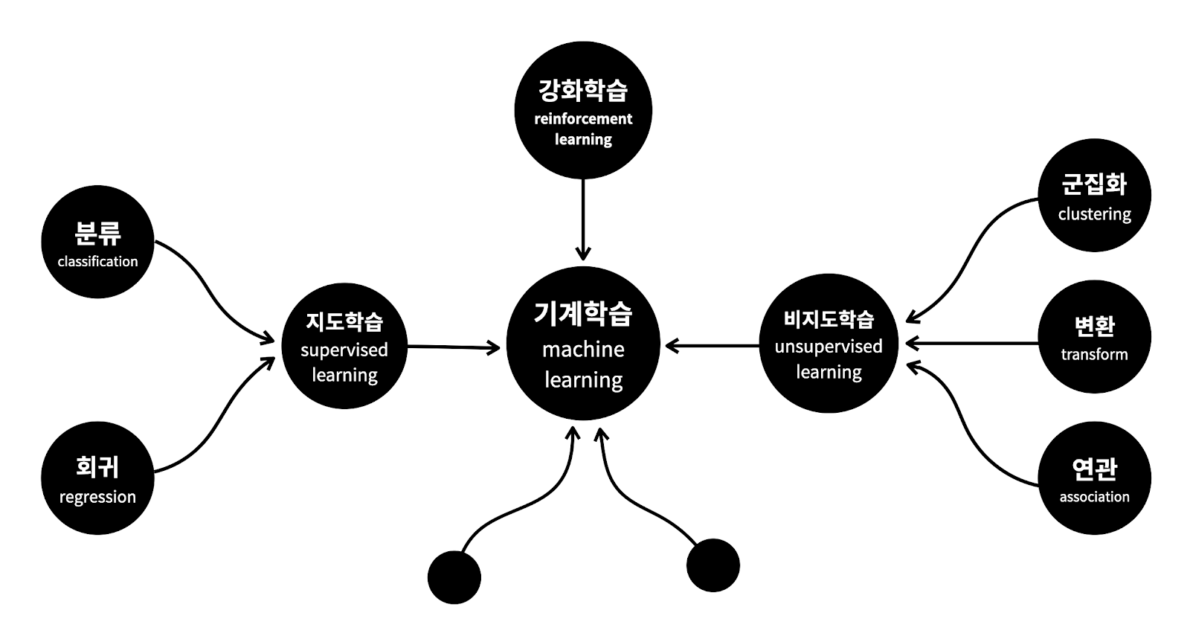
Before we get started…
Notes:
지도학습의 ‘지도'는 기계를 가르친다(supervised)는 의미입니다. 마치 문제집을 푸는 것과 비슷합니다. 문제집에는 문제가 있고, 정답이 있습니다. 문제와 정답을 비교하고 맞추다 보면 문제풀이에 익숙해지게 됩니다. 이후에 비슷한 문제를 만나면 오답에 빠질 확률은 점점 낮아집니다. 문제집으로 학생을 가르치듯이 데이터로 컴퓨터를 학습시켜서 모델을 만드는 방식을 ‘지도학습’이라고 합니다.
비지도학습은 지도학습에 포함되지 않는 방법들입니다. 여기에 속하는 도구들은 대체로 기계에게 데이터에 대한 통찰력을 부여하는 것이라고 이야기할 수 있을 것 같습니다. '통찰'의 사전적 의미는 '예리한 관찰력으로 사물을 꿰뚫어 봄'입니다. 즉, 누가 정답을 알려주지 않았는데도 무언가에 대한 관찰을 통해 새로운 의미나 관계를 밝혀내는 것이라고 할 수 있습니다. 데이터의 성격을 파악하거나 데이터를 잘 정리정돈 하는 것에 주로 사용됩니다. 이해가 안 되죠? 안되는게 정상입니다. 그러니 걱정하지 마세요.

Slide 4
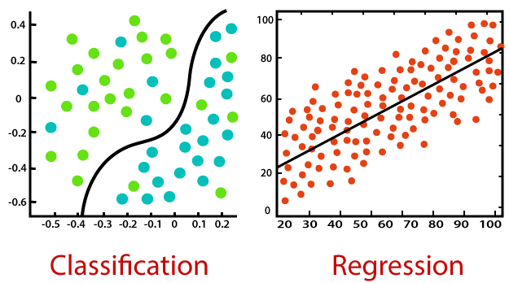
Before we get started…
Classification and Regression
[1] Regression vs Classification in Machine Learning

Slide 5
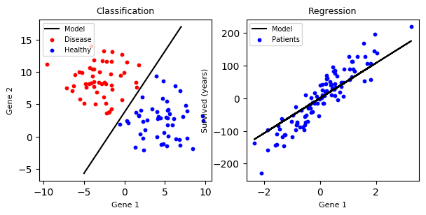
Before we get started…
Classification
Discrete Problem!(0 or 1)
[2] Classification

Slide 6
Before we get started…
Classification
Continuous Problem!
[2] Classification

Slide 7
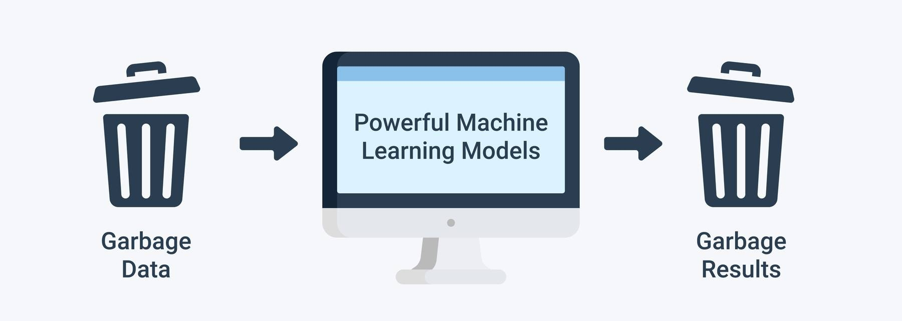
Before we get started…
Garbage In Garbage Out

Slide 8
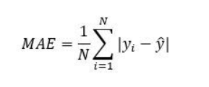
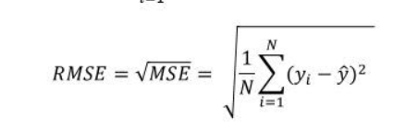
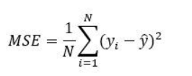
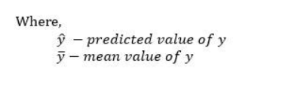
Performance Metrics
Regression
[3] MAE, MSE and RMSE

Slide 9
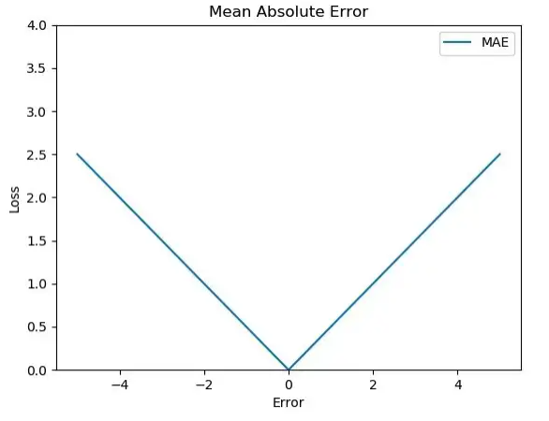
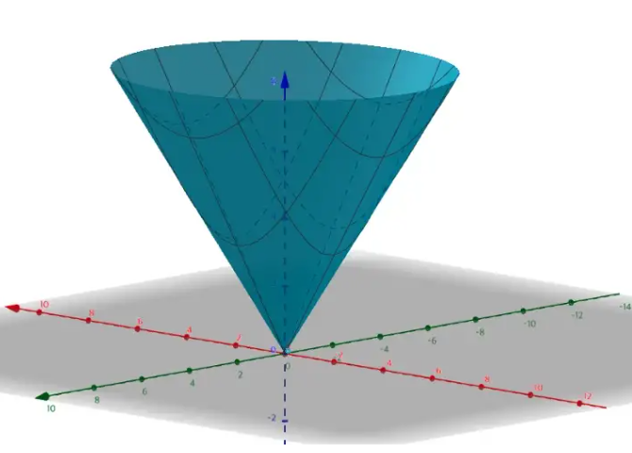
Performance Metrics
Regression
Common Problems
Loss is positive
Scale dependant
[3] MAE, MSE and RMSE

Slide 10
Performance Metrics
Regression
 | MAE | MSE | RMSE
PROS | Intuitive | Good for big errors | Good for big errors
CONS | Not differentiable at 0 | Hard to deal with large value, Not robust | Not Intuitive
[3] MAE, MSE and RMSE

Slide 11
Performance Metrics
Regression
Strategy
Use RMSE as Loss function
And
Use MAE for performance check only!
[3] MAE, MSE and RMSE

Slide 12
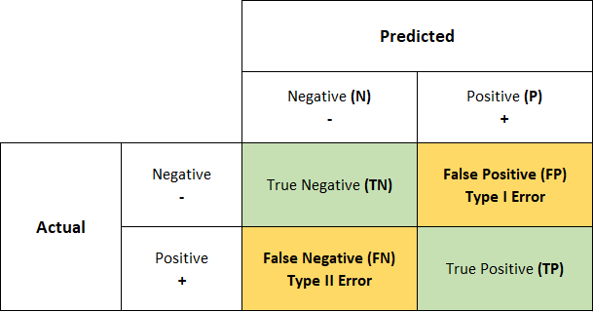
Performance Metrics
Classification
Confusion matrix
[4] Confusion matrix

Slide 13
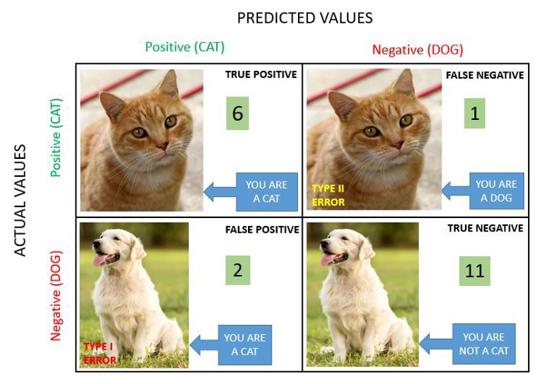
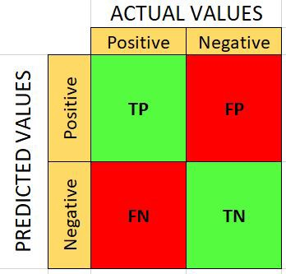
Performance Metrics
Classification
Ground truth!
A simple example
- Cat and dog
[4] Confusion matrix

Slide 14


Performance Metrics
Classification
[4] Confusion matrix

Slide 15
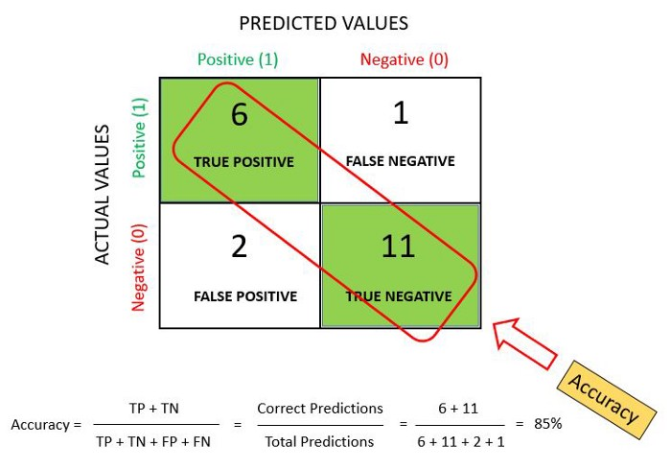
Performance Metrics
Accuracy (ACC), 정확도
[4] Confusion matrix

Slide 16
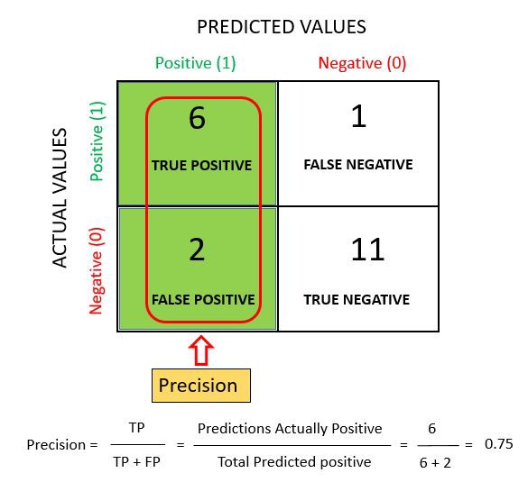
Performance Metrics
Precision, 정밀도
Positive Predictive Value (PPV)
[4] Confusion matrix

Slide 17
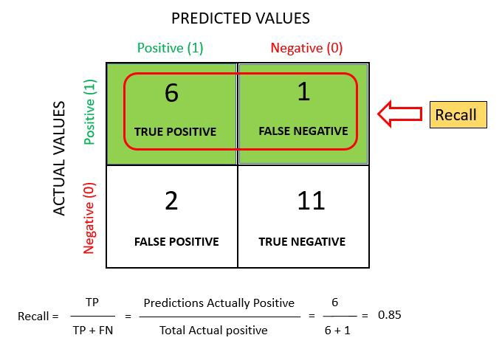
Performance Metrics
Sensitivity(Recall), 민감도
True Positive Rate (TPR)
[4] Confusion matrix

Slide 18
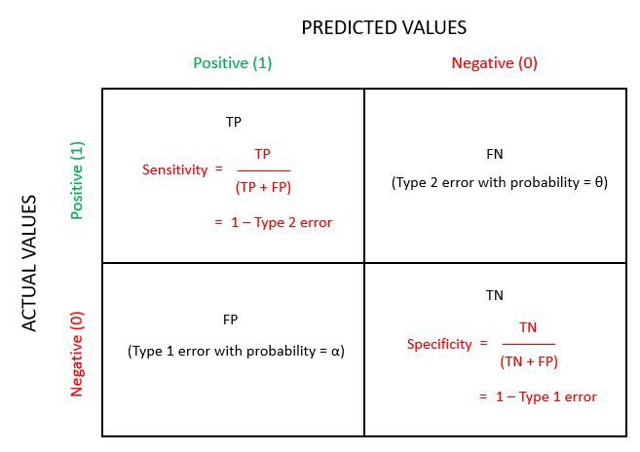
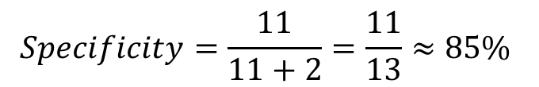
Performance Metrics
Specificity, 특이도
True Negative Rate (TNR)
$$Specificity=\frac{11}{11+2}=\frac{11}{13}≈85\%$$
[4] Confusion matrix

Slide 19
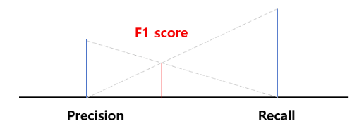
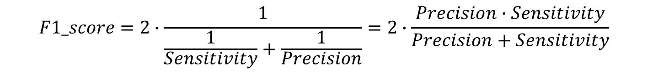
Performance Metrics
F1-score
Harmonic mean
$$F1_score=2∙\frac{1}{\frac{1}{Sensitivity}+\frac{1}{Precision}}=2∙\frac{Precision∙Sensitivity}{Precision+Sensitivity}$$
[4] Confusion matrix
[5] Harmonic mean

Slide 20
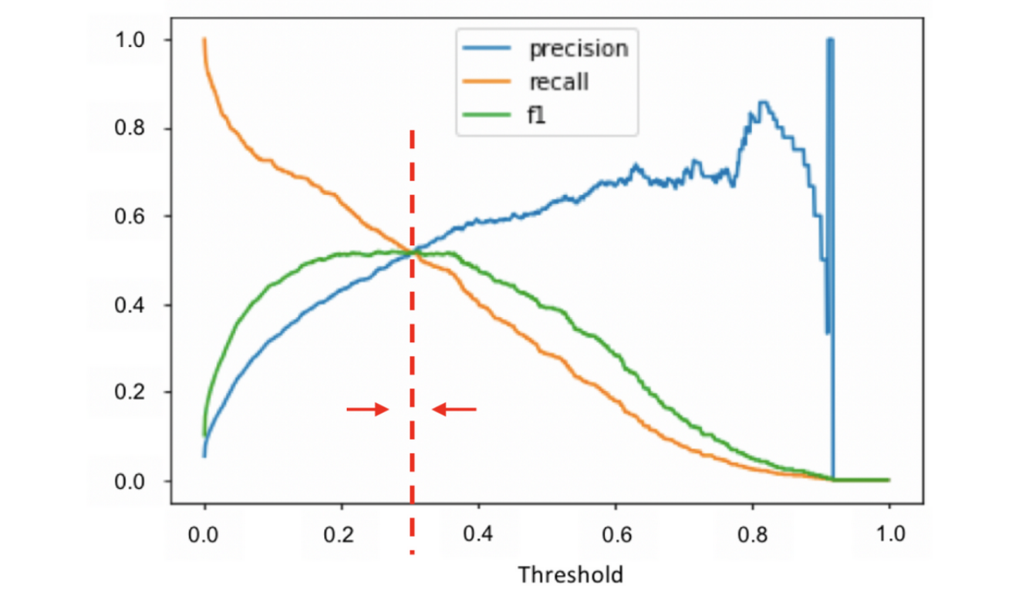
Performance Metrics
F1-score
[4] Confusion matrix

Slide 21
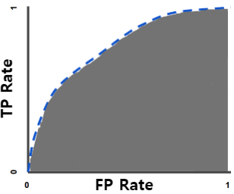
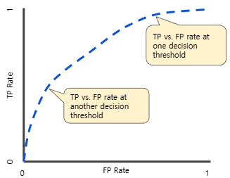
Performance Metrics
AUC and ROC
ROC curve (receiver operating characteristic curve)
AUC (Area Under Curve)
[6] AUC and ROC

Slide 22
Performance Metrics
Why/When do we need to perform scaling?
PCA
Clustering (k-NN, K-means, DBSCAN, …)
Deep Neural Network
Tree based model
(Decision Tree, Random Forest, Boosting, …)
Distance-dependent
Need to be scaled!
Distance-independent
Doesn’t need to be scaled!

Slide 23
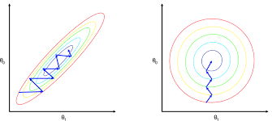
Performance Metrics
Data Scaling

Slide 24
Performance Metrics
Data Scaling

Slide 25
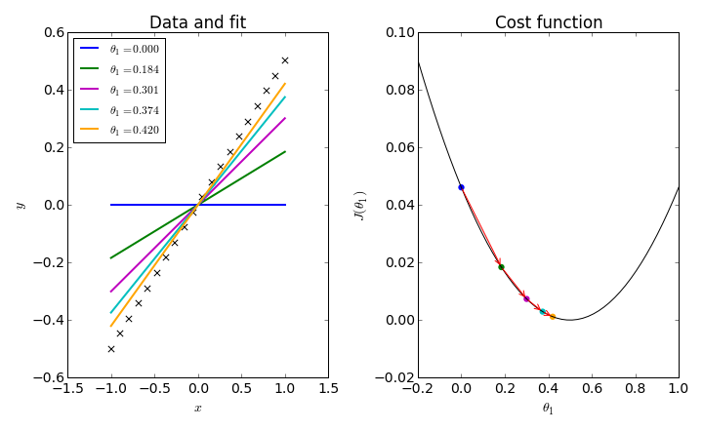
Performance Metrics
Data Scaling

Slide 26
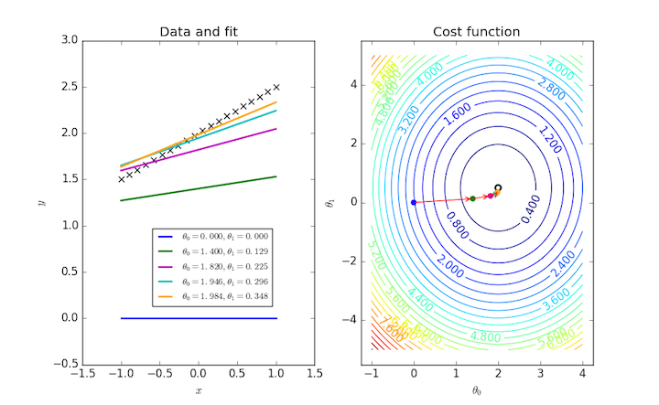
Performance Metrics
Data Scaling

Slide 27
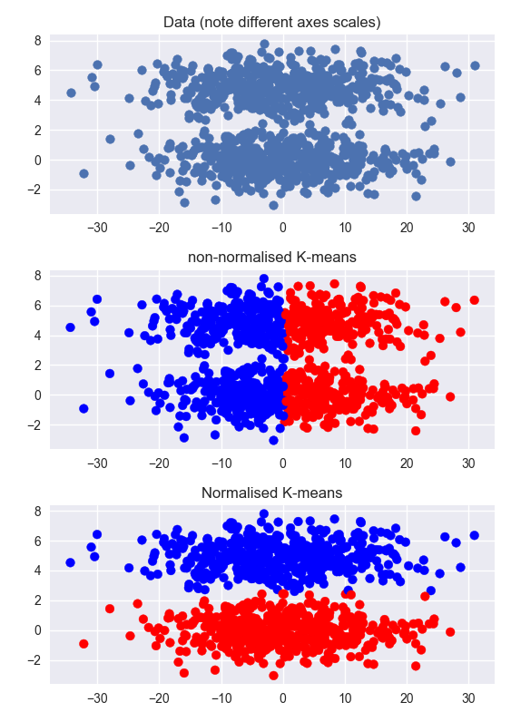
Performance Metrics
Data Scaling

Slide 28
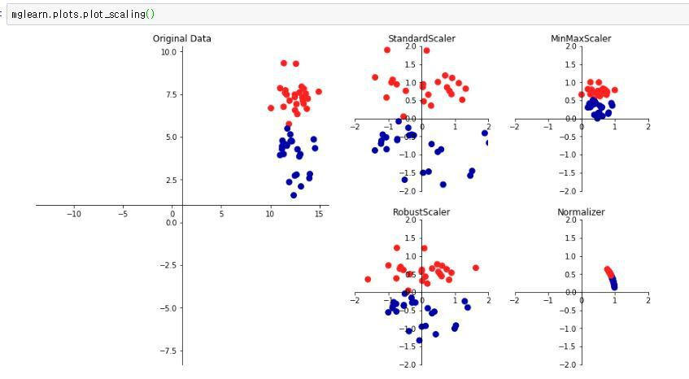
Performance Metrics
Normalization

Slide 29
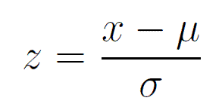
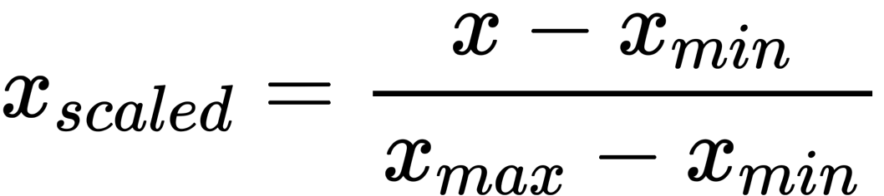
Performance Metrics
Normalization
Minmax scaling
Standard scaling

Slide 30
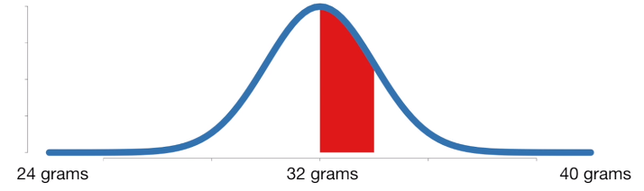
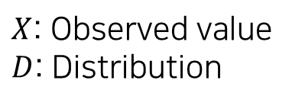
Concept of Likelihood
Probability vs Likelihood
$$Probability=P\left(X | D\right)$$
$X$: Observed value
$D$: Distribution
$$P\left(weight between 32 and 34 grams | mean=32 and stdev=2.5\right)$$
[7] Probability, Likelihood and Likelihood Maximization

Slide 31
Concept of Likelihood
Probability vs Likelihood
$$P\left(weight between 32 and 34 grams | mean=32 and stdev=2.5\right)$$
Probability
Area under distribution (probability that SOMETHING will be observed) with ‘specified distribution’
== Distribution is fixed
& Observation is variable!
[7] Probability, Likelihood and Likelihood Maximization

Slide 32
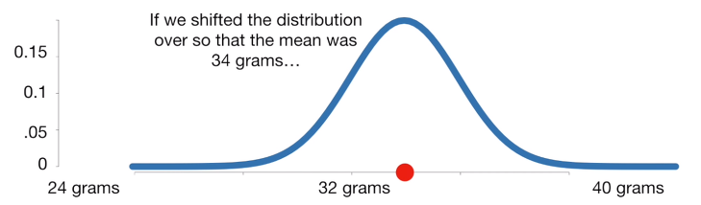
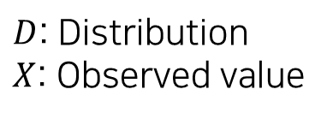
Concept of Likelihood
Probability vs Likelihood
$$Likelihood=L\left(D | X\right)$$
$D$: Distribution
$X$: Observed value
$$L\left(mean=34 and stdev=2.5 | weight=34\right)$$
[7] Probability, Likelihood and Likelihood Maximization

Slide 33
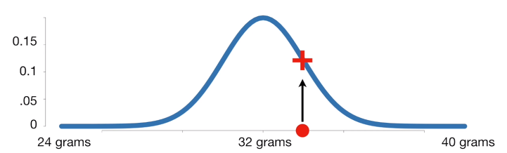
Concept of Likelihood
Probability vs Likelihood
$$L\left(mean=32 and stdev=2.5 | weight=34\right)$$
Likelihood
A probability that the value sampled from a given observation came from that probability distribution
== Observation is fixed
& Distribution is variable!
[7] Probability, Likelihood and Likelihood Maximization

Slide 34
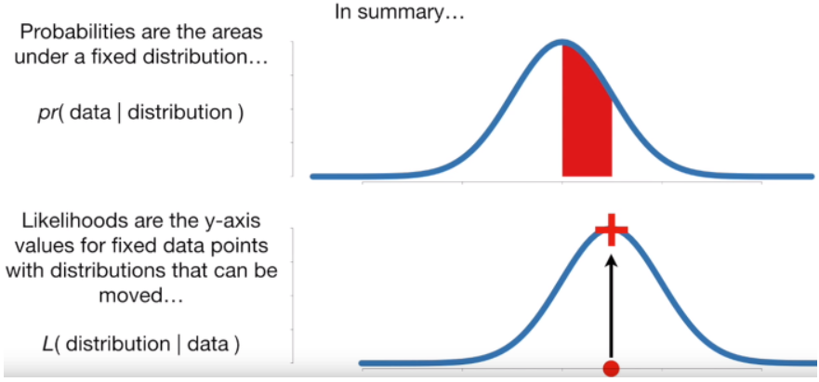
Concept of Likelihood
Summary
Probability: Observation given Distribution (Distribution is fixed)
Likelihood: Distribution given Observation (Data is fixed)
[8] An animation for explanation of Likelihood
[7] Probability, Likelihood and Likelihood Maximization

Slide 35
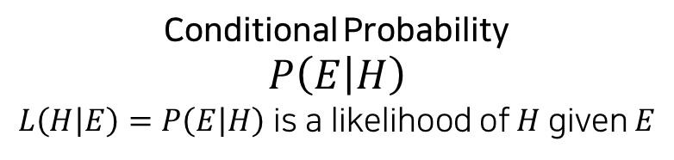
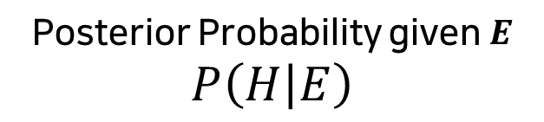
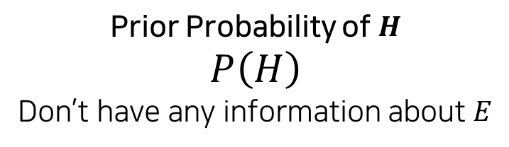
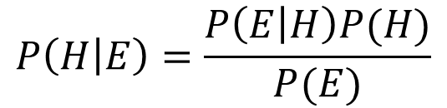
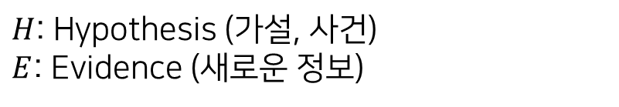
Bayes Theorem
Conditional Probabilistic approach
$$P\left(H | E\right)=\frac{P\left(E | H\right)P(H)}{P(E)}$$
Prior Probability of $H$
$$P\left(H\right)$$
Don’t have any information about $E$
Posterior Probability given $E$
$$P\left(H | E\right)$$
Conditional Probability
$$P\left(E | H\right)$$
$L\left(H | E\right)=P\left(E | H\right)$ is a likelihood of $H$ given $E$
$H$: Hypothesis (가설, 사건)
$E$: Evidence (새로운 정보)
[9] Bayes' theorem

Slide 36

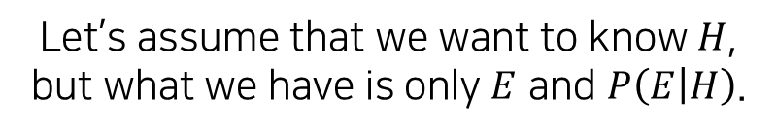
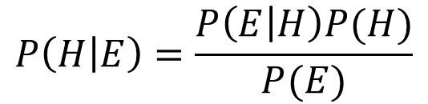
Bayes Theorem
Conditional Probabilistic approach
$$P\left(H | E\right)=\frac{P\left(E | H\right)P(H)}{P(E)}$$
Let’s assume that we want to know $H$,
but what we have is only $E$ and $P\left(E | H\right)$.
We can get $P\left(H | E\right)$ using Bayes Theorem!
$H$: Hypothesis (가설, 사건)
$E$: Evidence (새로운 정보)
[9] Bayes' theorem

Slide 37
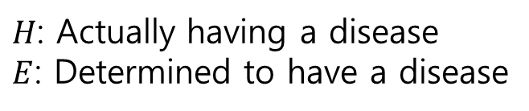
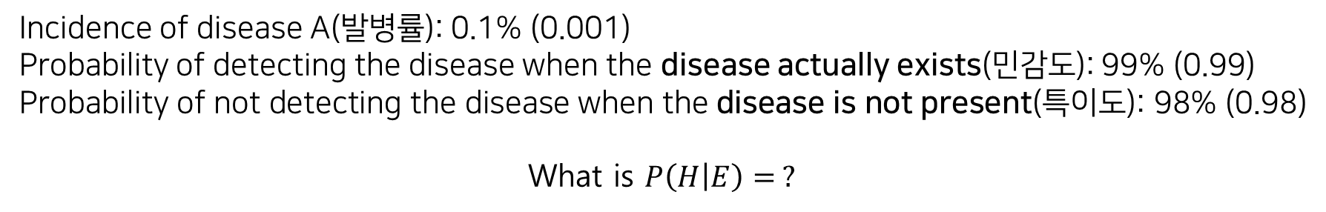
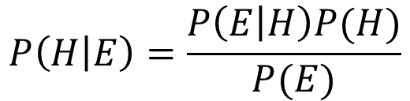
Bayes Theorem
Example
$$P\left(H | E\right)=\frac{P\left(E | H\right)P(H)}{P(E)}$$
Incidence of disease A(발병률): 0.1% (0.001)
Probability of detecting the disease when the disease actually exists(민감도): 99% (0.99)
Probability of not detecting the disease when the disease is not present(특이도): 98% (0.98)
What is $P\left(H | E\right)= ?$
$H$: Actually having a disease
$E$: Determined to have a disease
[10] Test reagent problem

Slide 38
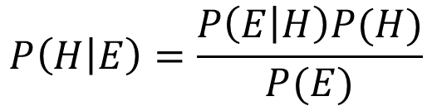
Bayes Theorem
Example
$$P\left(H | E\right)=\frac{P\left(E | H\right)P(H)}{P(E)}$$
Incidence of disease A(발병률): 0.1% (0.001)
Probability of detecting the disease when the disease actually exists(민감도): 99% (0.99)
Probability of not detecting the disease when the disease is not present(특이도): 98% (0.98)
$$P\left(H\right)=0.001=Incidence of getting disease A$$
$P\left(E | H\right)=0.99=Actually having a disease, determined to have a disease$(True Positive)
$P\left(E^{c} | H^{c}\right)=0.98=Actually not having a disease, determined not to have a disease$(True Negative)
$H$: Actually having a disease
$E$: Determined to have a disease
[10] Test reagent problem

Slide 39
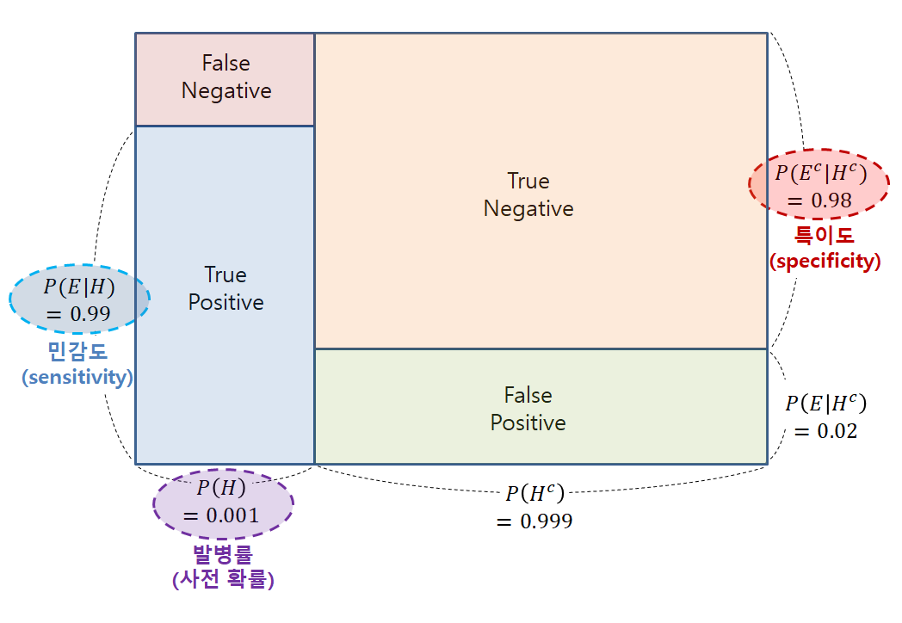
Bayes Theorem
Example
$$P\left(H | E\right)=\frac{P\left(E | H\right)P(H)}{P(E)}$$
$$P\left(H\right)=0.001=Incidence of getting disease A$$
$P\left(E | H\right)=0.99=Actually having a disease, determined to have a disease$(True Positive)
$P\left(E^{c} | H^{c}\right)=0.98=Actually not having a disease, determined not to have a disease$(True Negative)
$H$: Actually having a disease
$E$: Determined to have a disease
[10] Test reagent problem

Slide 40
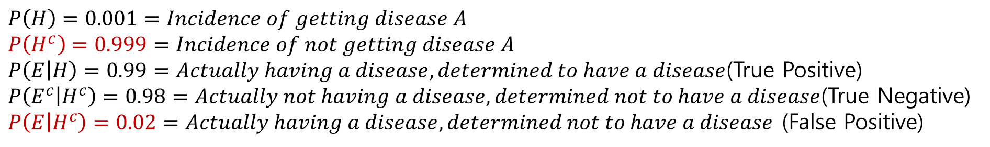
Bayes Theorem
Example
$$P\left(H | E\right)=\frac{P\left(E | H\right)P(H)}{P(E)}=\frac{P\left(E | H\right)P(H)}{P\left(E | H\right)P\left(H\right)+P\left(E | H^{c}\right)P(H^{c})}$$
$$P\left(H\right)=0.001=Incidence of getting disease A$$
$$P\left(H^{c}\right)=0.999=Incidence of not getting disease A$$
$P\left(E | H\right)=0.99=Actually having a disease, determined to have a disease$(True Positive)
$P\left(E^{c} | H^{c}\right)=0.98=Actually not having a disease, determined not to have a disease$(True Negative)
$P\left(E | H^{c}\right)=0.02=Actually having a disease, determined not to have a disease$ (False Positive)
$H$: Actually having a disease
$E$: Determined to have a disease
[10] Test reagent problem

Slide 41
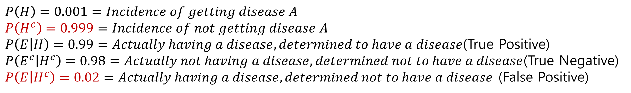

Bayes Theorem
Example
$$P\left(H\right)=0.001=Incidence of getting disease A$$
$$P\left(H^{c}\right)=0.999=Incidence of not getting disease A$$
$P\left(E | H\right)=0.99=Actually having a disease, determined to have a disease$(True Positive)
$P\left(E^{c} | H^{c}\right)=0.98=Actually not having a disease, determined not to have a disease$(True Negative)
$P\left(E | H^{c}\right)=0.02=Actually having a disease, determined not to have a disease$ (False Positive)
$$P\left(H | E\right)=\frac{P\left(E | H\right)P(H)}{P\left(E | H\right)P\left(H\right)+P\left(E | H^{c}\right)P(H^{c})}=\frac{0.99×0.001}{0.99×0.001+0.02×0.999}≈0.047=4.7\%=Determined to have a disease, actually having a disease$$
$$≠P\left(H\right)×P\left(E\right)=0.001998\%$$
$H$: Actually having a disease
$E$: Determined to have a disease
[10] Test reagent problem

Slide 42


Bayes Theorem
Practice
If a person who has already tested positive is tested again and tested positive again, what is the probability that this person will actually get the disease?
$P\left(H\right)=0.047=Incidence of getting disease A$ – Posterior changed to Prior!
$$P\left(H^{c}\right)=0.953=Incidence of not getting disease A$$
$P\left(E | H\right)=0.99=Actually having a disease, determined to have a disease$(True Positive)
$P\left(E^{c} | H^{c}\right)=0.98=Actually not having a disease, determined not to have a disease$(True Negative)
$P\left(E | H^{c}\right)=0.02=Actually having a disease, determined not to have a disease$ (False Positive)
$$P\left(H | E\right)=\frac{P\left(E | H\right)P(H)}{P\left(E | H\right)P\left(H\right)+P\left(E | H^{c}\right)P(H^{c})}=\frac{0.99×0.047}{0.99×0.047+0.02×0.953}≈0.709≈71\%$$
$H$: Actually having a disease
$E$: Determined to have a disease
[10] Test reagent problem

Slide 43


Exercise
Min-max scaling
Standard scaling
Hint
Mean: 4
Variance(sigma^2): 12
Data: [-1, 1, 3, 5, 7, 9]
Calculate the scaled result
Notes:
끝

Slide 44
Exercise
Min-max scaling
Standard scaling
Hint
Mean: 4
Variance(sigma^2): 12
Data: [-1, 1, 3, 5, 7, 9]
Calculate the scaled result
Notes:
끝

Slide 45
Exercise
Min-max scaling
Standard scaling
Hint
Mean: 4
Variance(sigma^2): 12
Data: [-1, 1, 3, 5, 7, 9]
Data: [-1, 1, 3, 5, 7, 9]
Notes:
끝

